Slide 1
Tableau histogram
By: Nana Prempeh

Slide 2
Histogram Description
The following plots are based on data related to automobiles and additional factors that are considered when most people are looking to purchase an automobile such as make,model,horsepower,price,body type and price just to name a few variables used the following plots will display the averages of prices of automobiles associated with make,body type and horsepower whilst also giving some general knowledge on the each of the car makes.

Slide 3
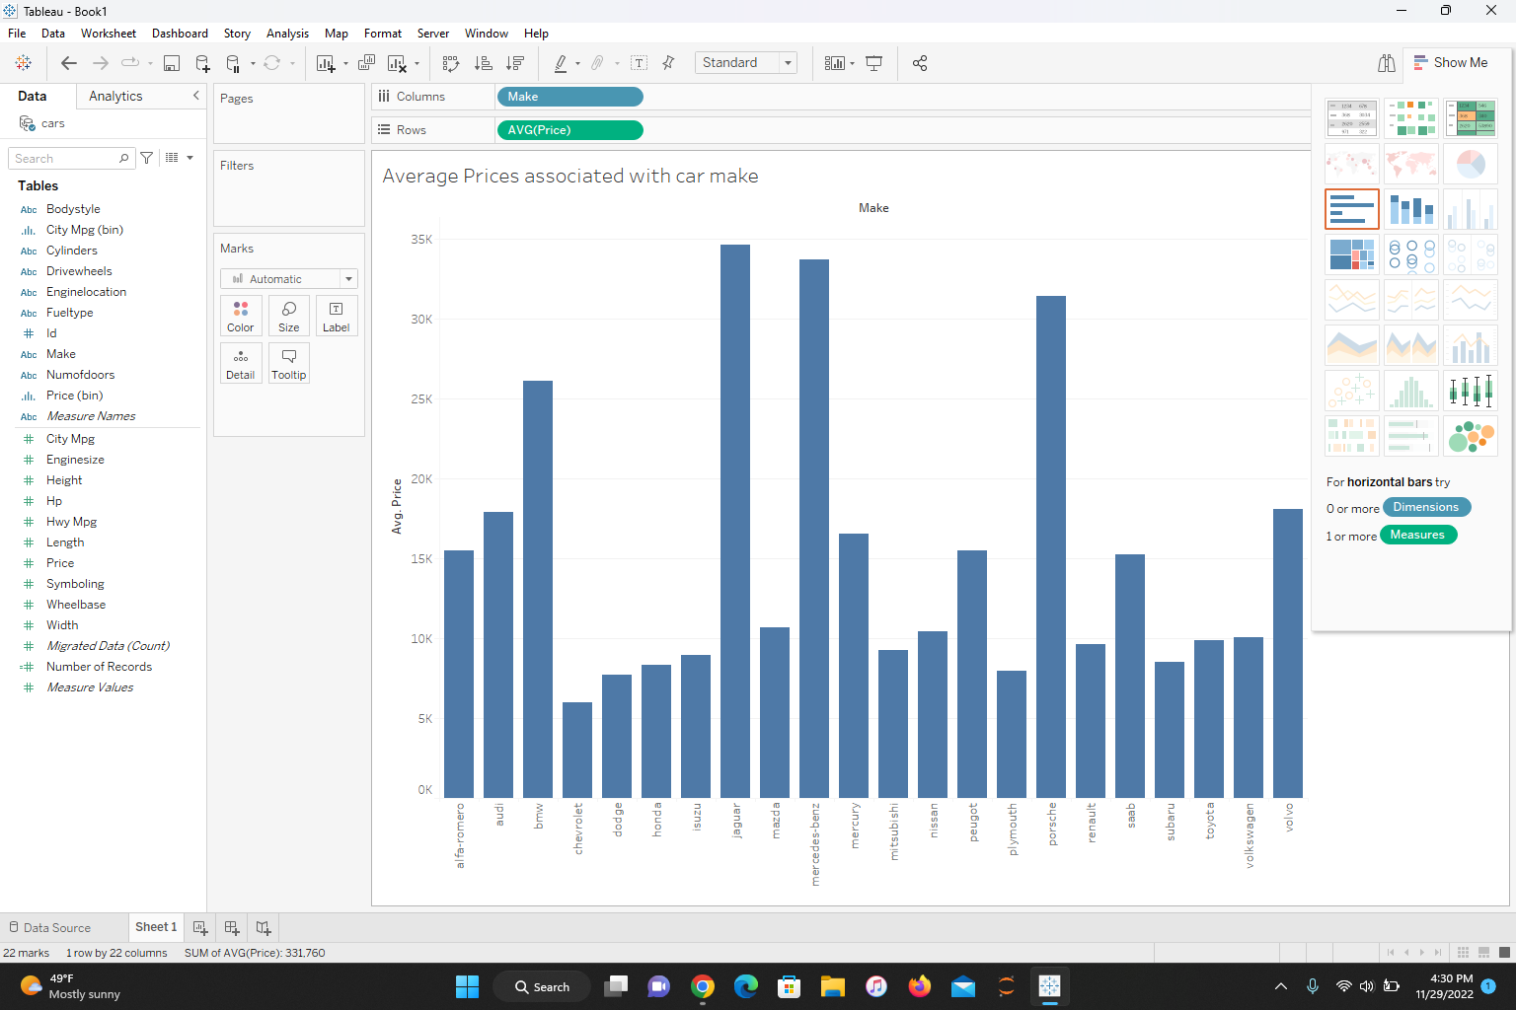
Histograms created

Slide 4
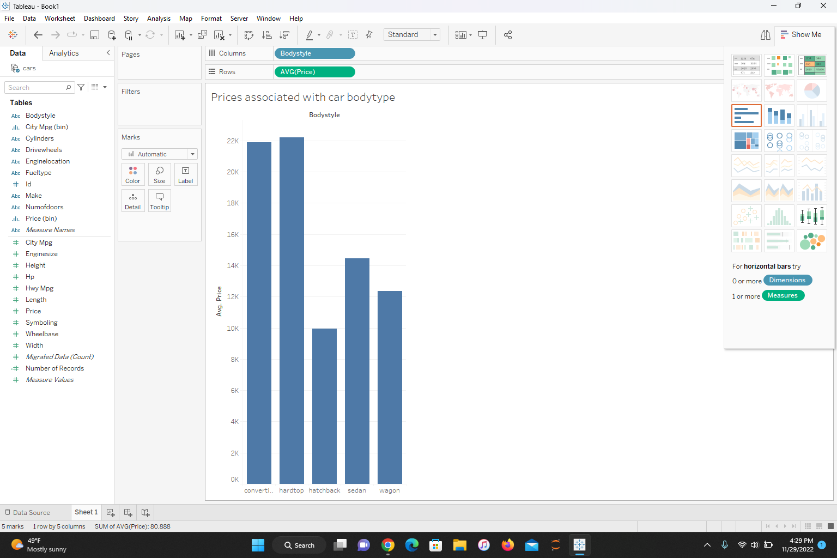

Slide 5
